Slide 1
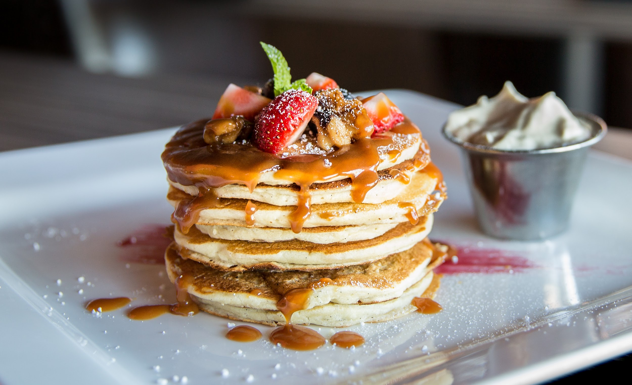
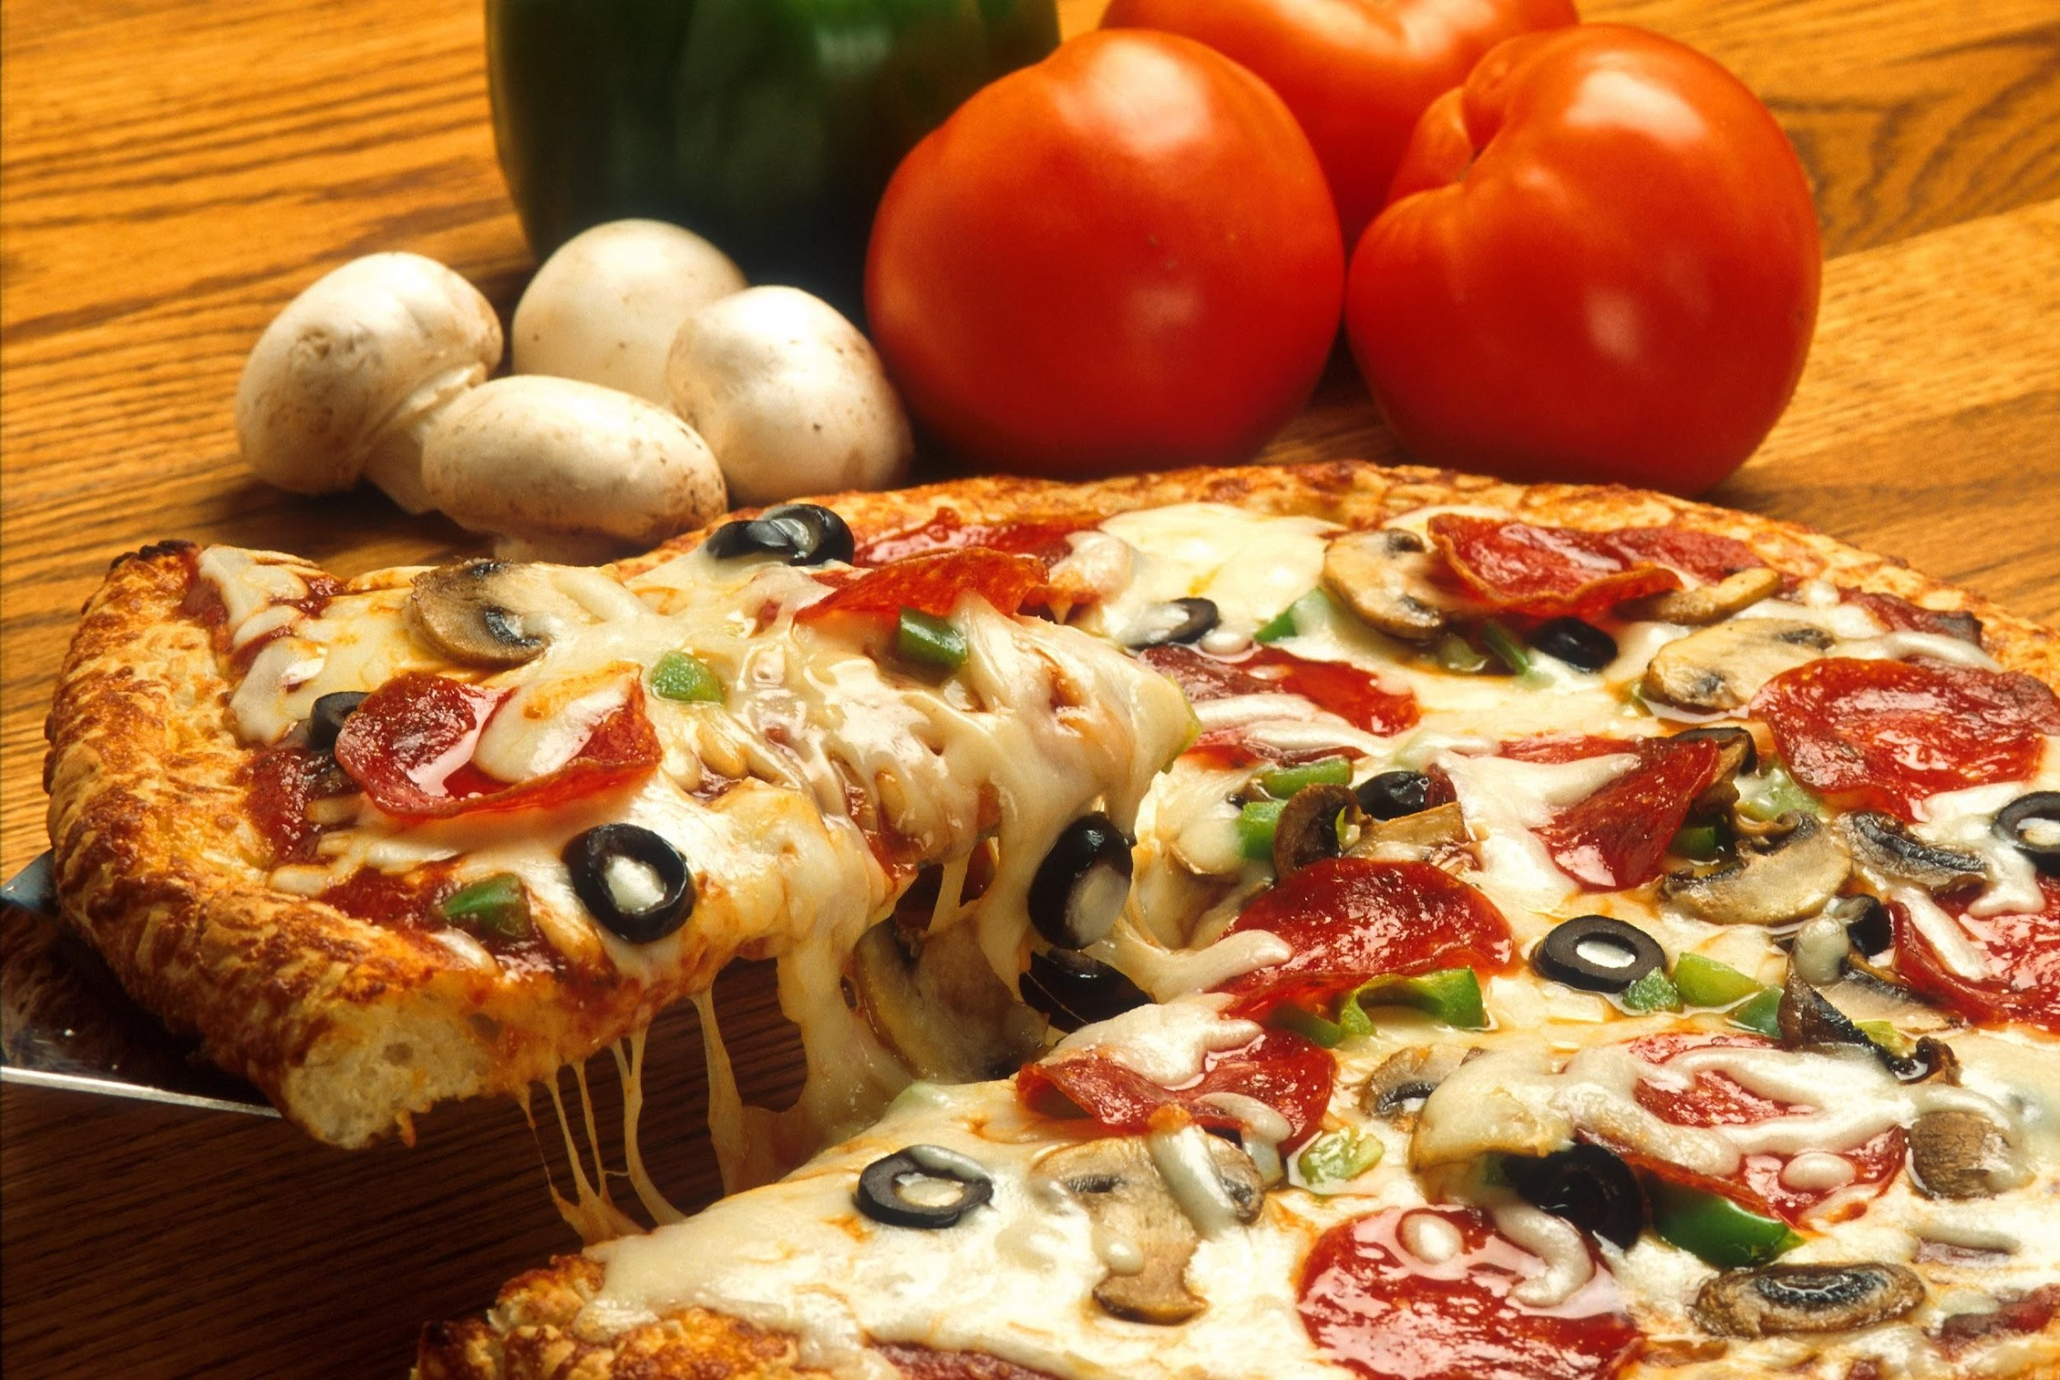
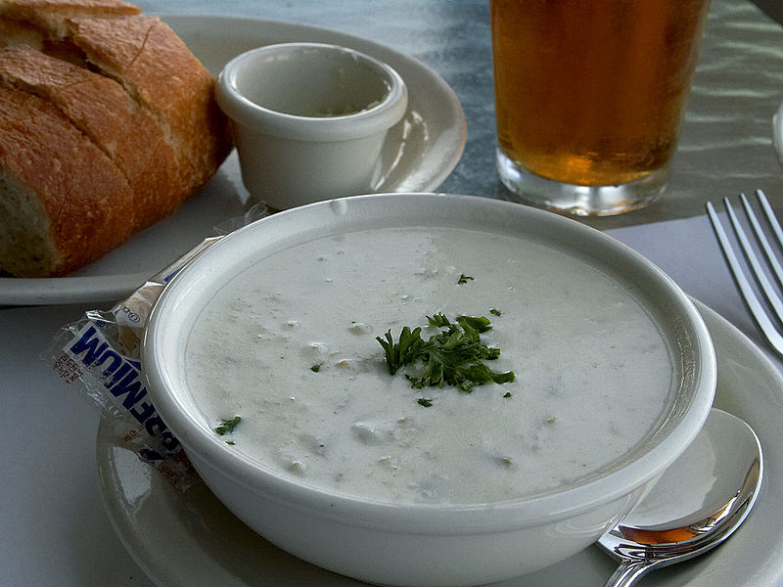

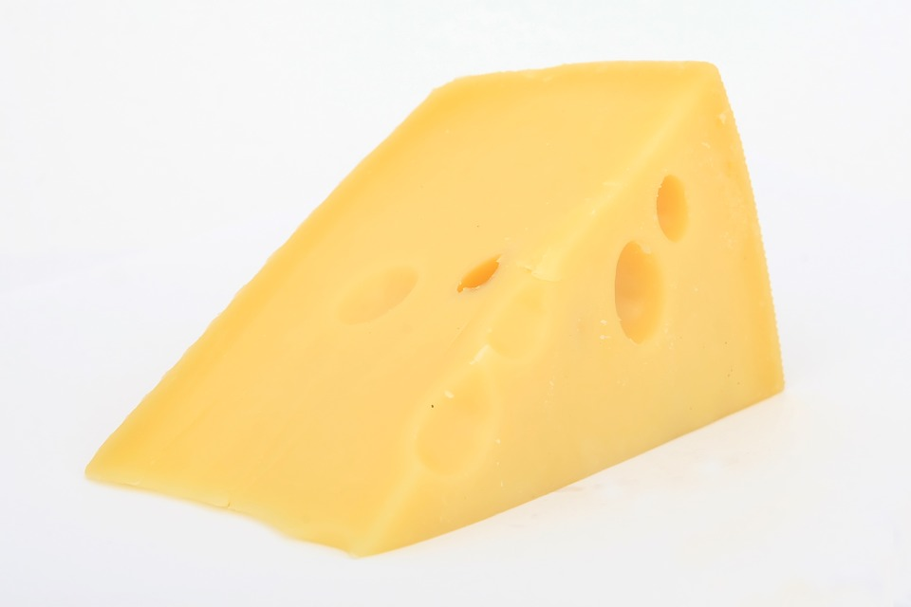

Weekly Meal Planner
Hadi Abbas
COMSC 165
17 May 2017
Professor Gentry-Kolen

Slide 2
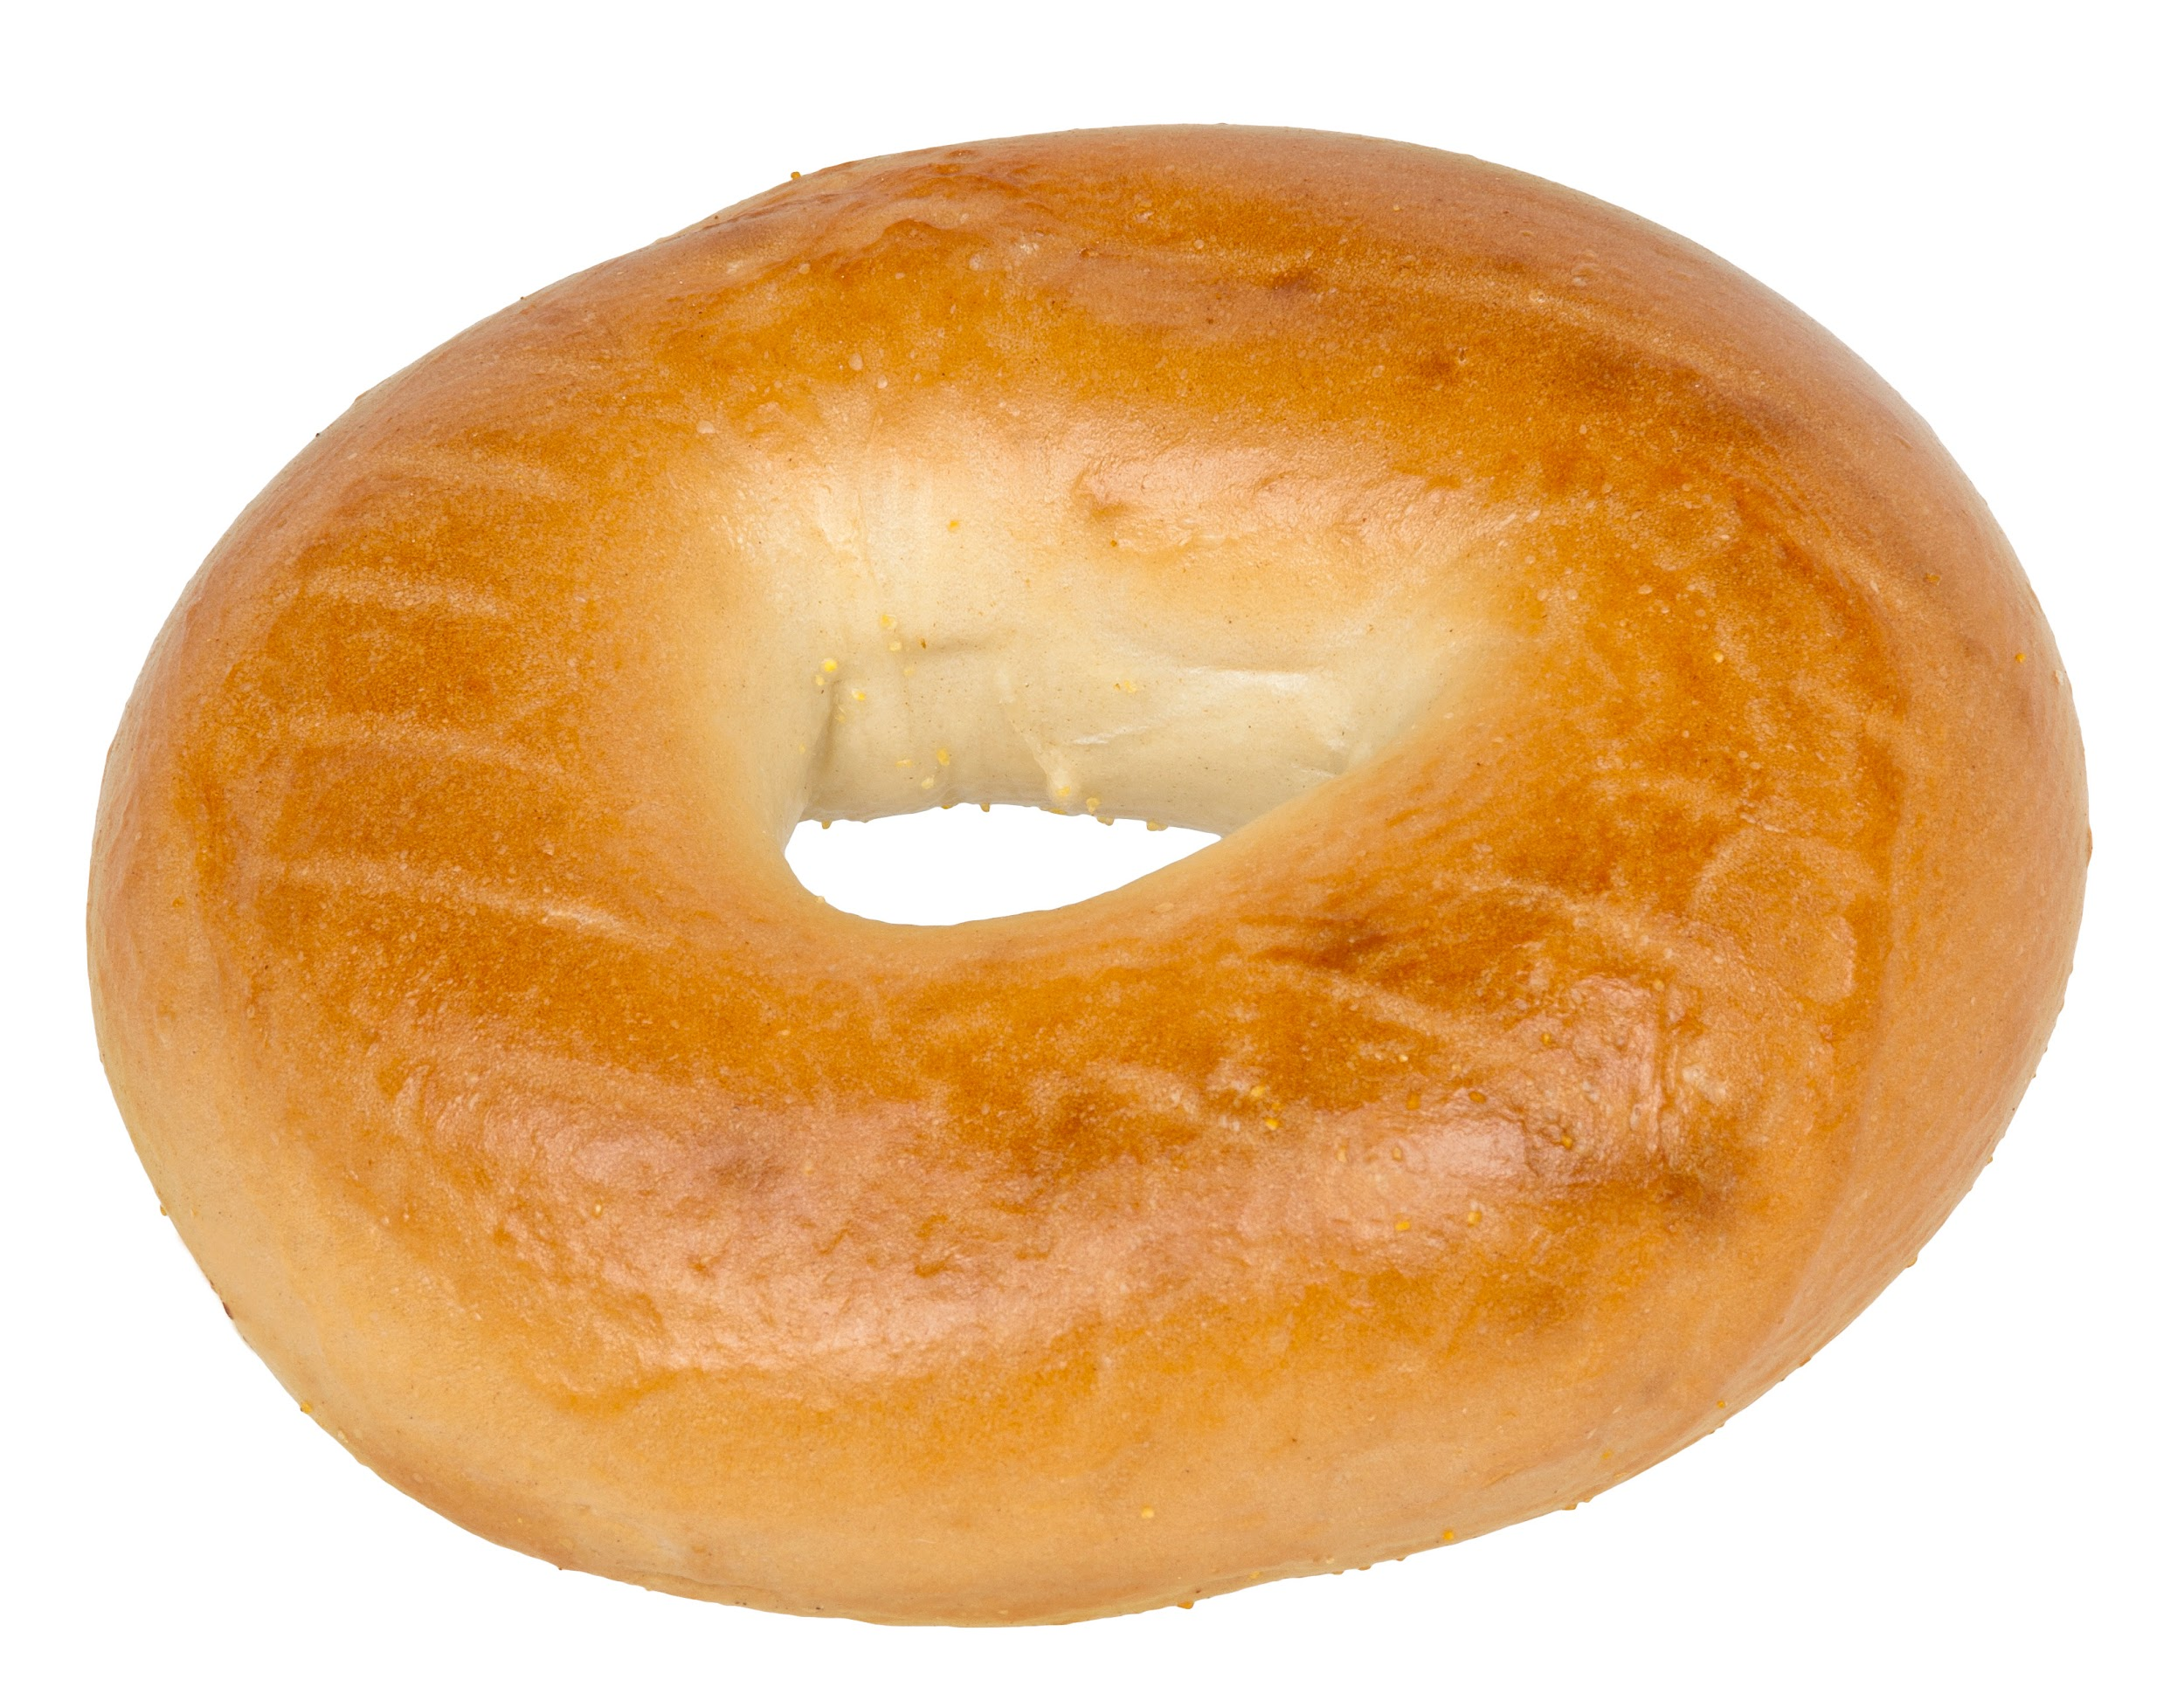

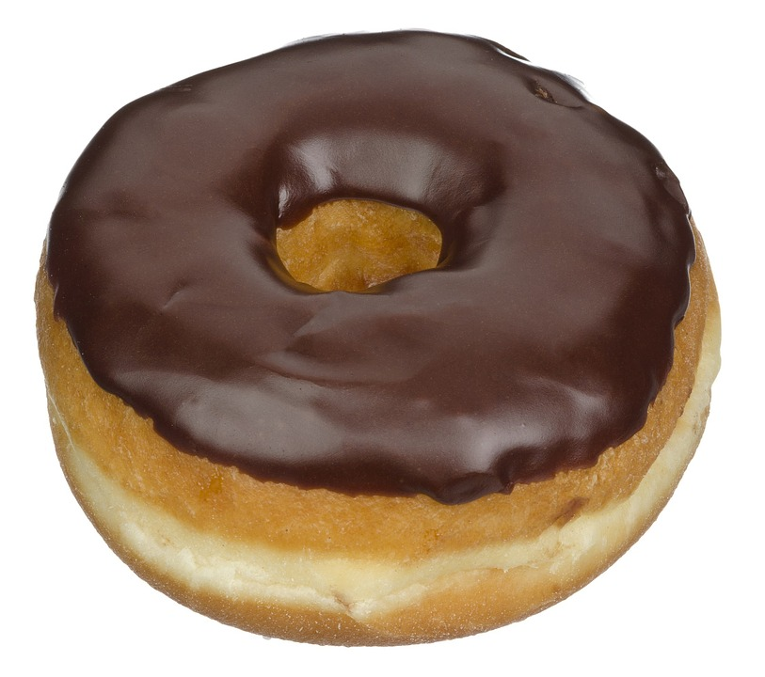
Background
Deciding what to eat is a problem many people face on a daily basis.
This program provides the user with a weekly meal plan encompassing a variety of menu items and food groups.
The project randomly generates a meal plan for a week consisting of five daily meals (breakfast, lunch, dinner, and two snacks).
Menu is saved to a file and can be printed.

Slide 3
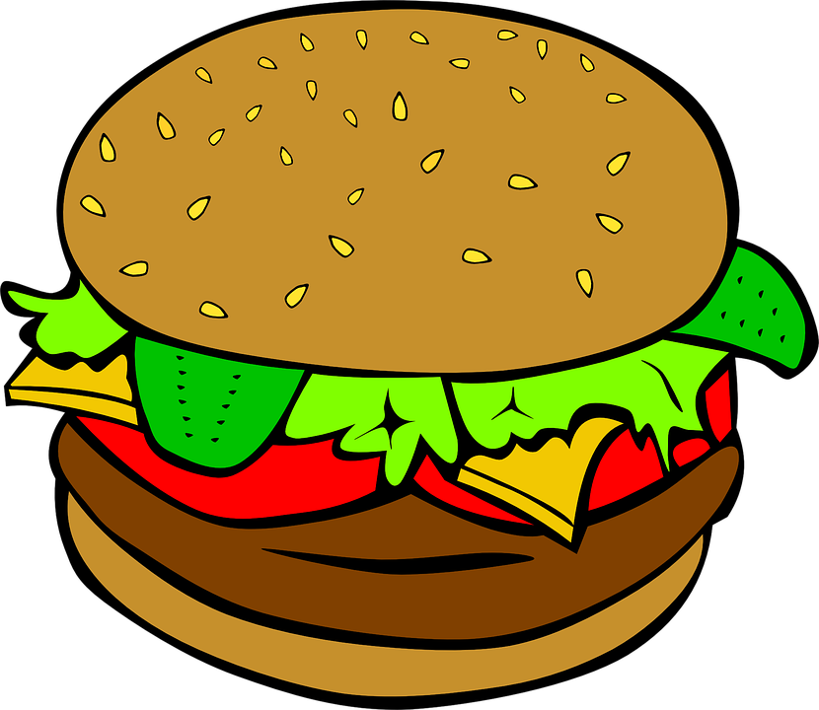
Program Files
Days.h header file
Defines the Days class
Contains five private member variables:
All are are static string const arrays used to store the different food possibilities for each meal.
Contains public member functions and variables:
Functions: Days ( ), void print ( )
Variables: struct Day which contains six string member variables and vector <Day> week

Slide 4
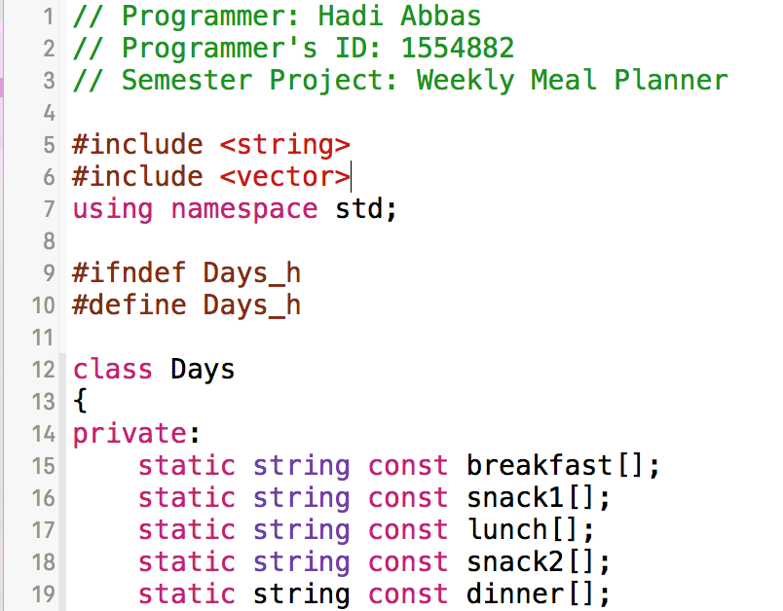
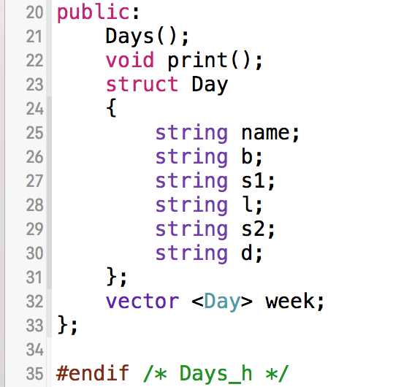
This is the “Days.h” header file described on the previous slide. The structure is created to represent each individual day in a week. Directly below the structure definition, a vector of Day is declared to store seven Day variables (represent a week). This becomes particularly useful when formatting the meal plan as a table later on.

Slide 5

Program Files (con.)
Days.cpp
Defines and stores values in the five string const arrays
Uses a print( ) function to randomly generate numbers which are then stored in vector<int>positions
The random values in the position vector are used to randomly select food items for the five meals for seven different instances of the Day structure (one for each day of the week).

Slide 6

Program Files (con.)
Days.cpp (con.)
The Day variables are now stored in the vector<Day>week.
Using headers and output formatting with the setw and left functions (#include <iomanip> and <iostream>), the Day variables are printed one by one in a table format.
This same formatting is used to output to a file of the user’s choice.
The user is prompted to enter a filename.
If it does not exist, it is automatically created.

Slide 7
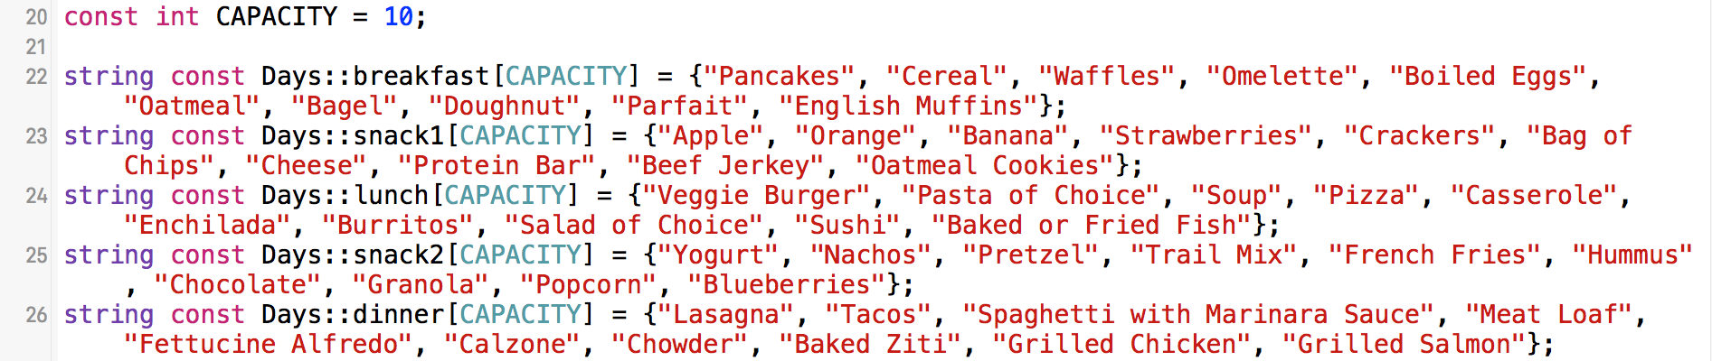
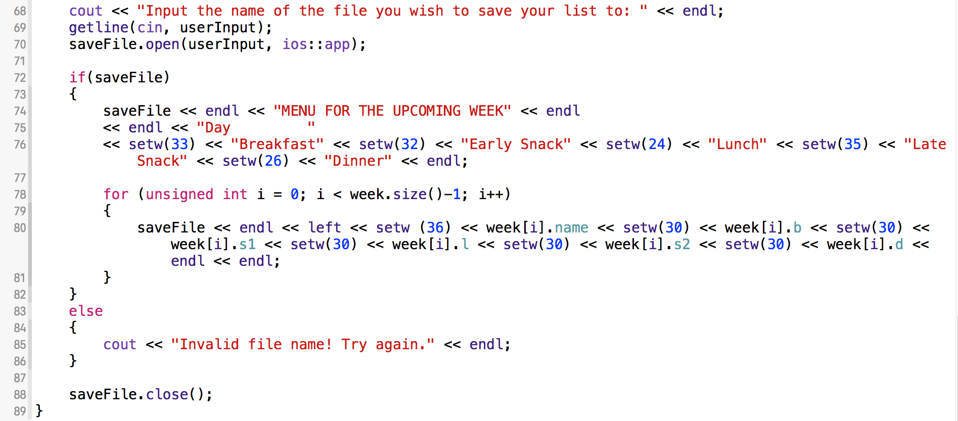
These are some excerpts from “Days.cpp”. The food items included for this example are stored in their respective arrays (above). The file output is demonstrated with formatting using a for loop, setw, left, and conditional statements (left).

Slide 8
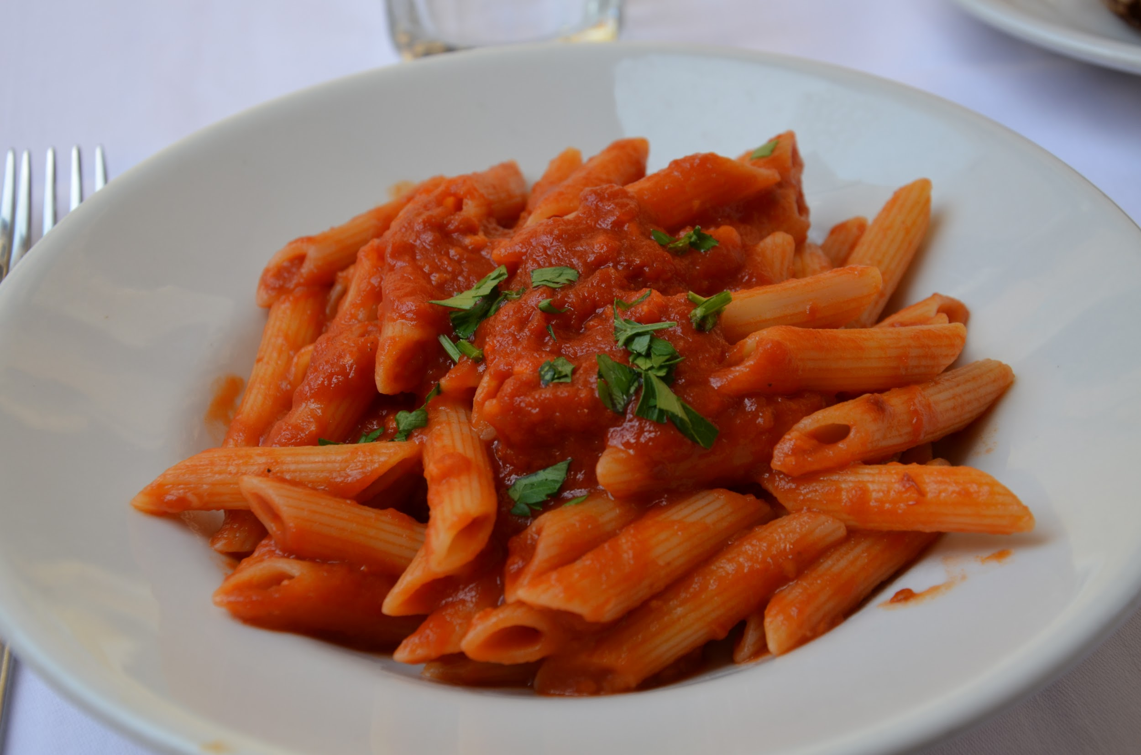
Program Files (con.)
main.cpp
int main( )
Prints welcome message and calls generate( )
void generate( ) function
Creates a Days object called week1
The constructor Days( ) is automatically created.
Days( ) calls other member functions to generate, print, and save a menu, as described in previous slides.

Slide 9
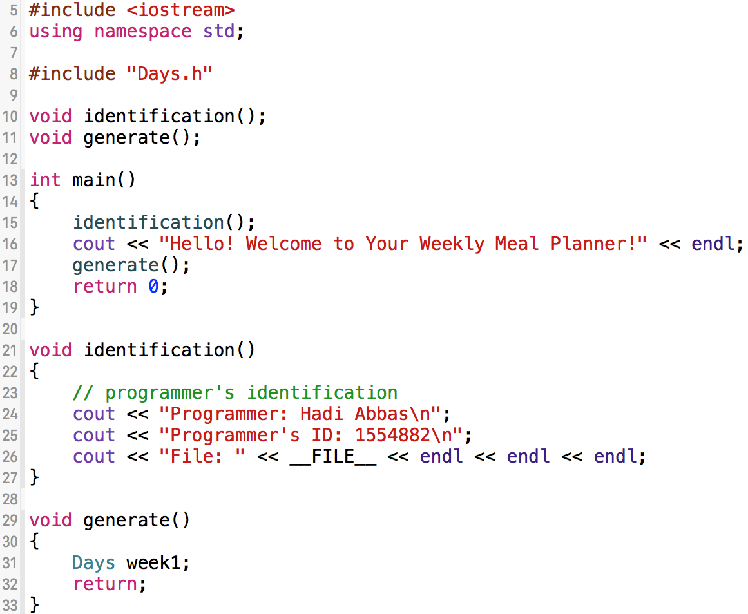
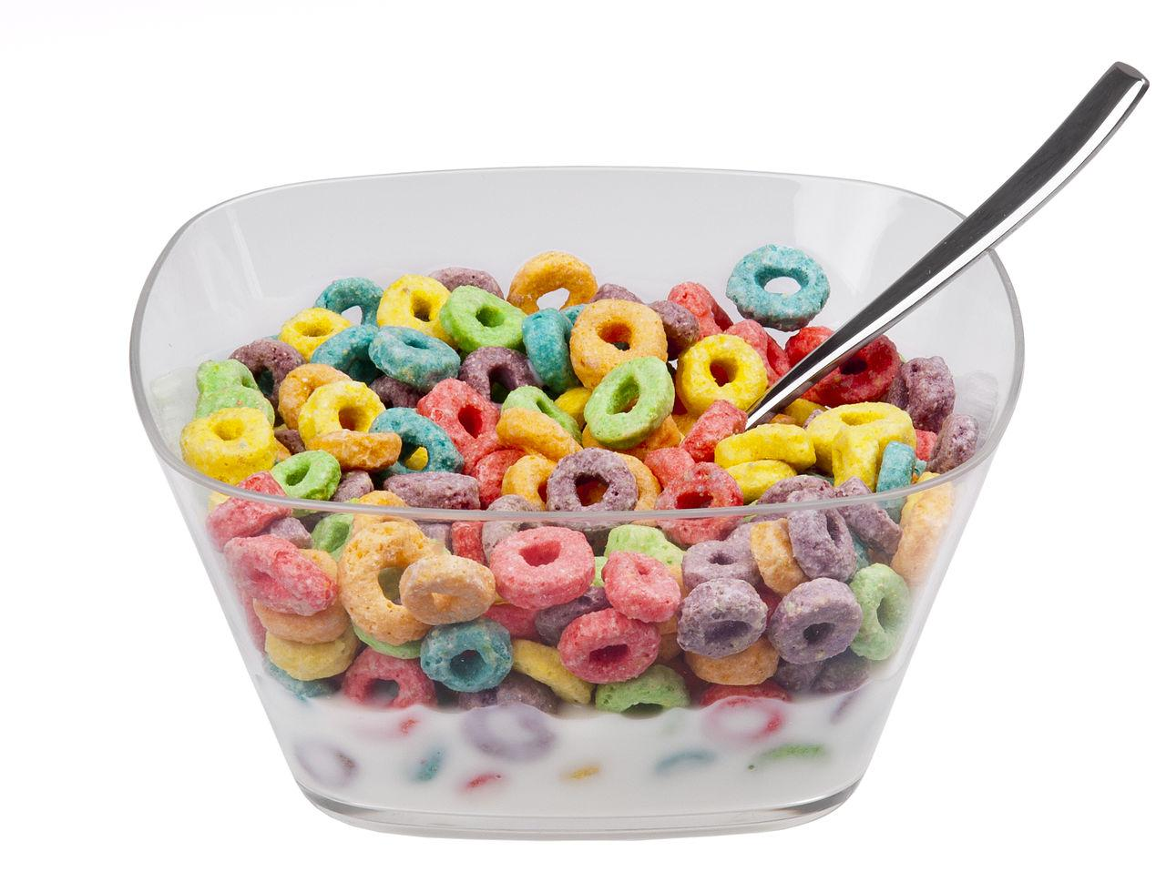
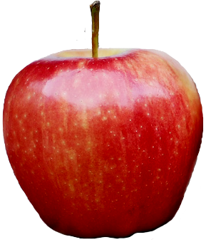
main.cpp is depicted to the left. It consists of three functions including int main( ), an identification function to print programmer information, and a generate function that creates a Days object named week1.

Slide 10
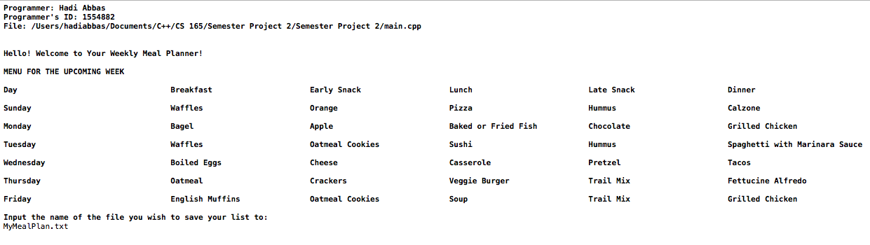
Console Output

Slide 11
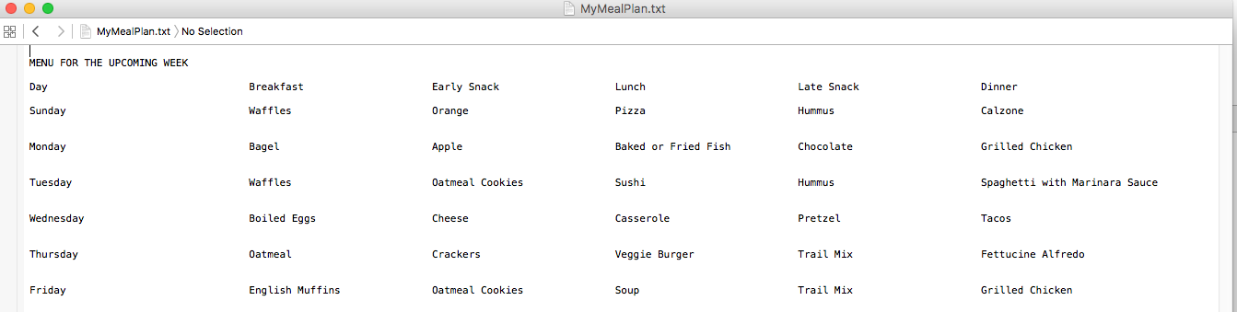
File Output

Slide 12
